Slide 1

Toward Intelligent Control Systems for Space Debris Mitigation
Blaine Swieder 10/27/2025

Slide 2

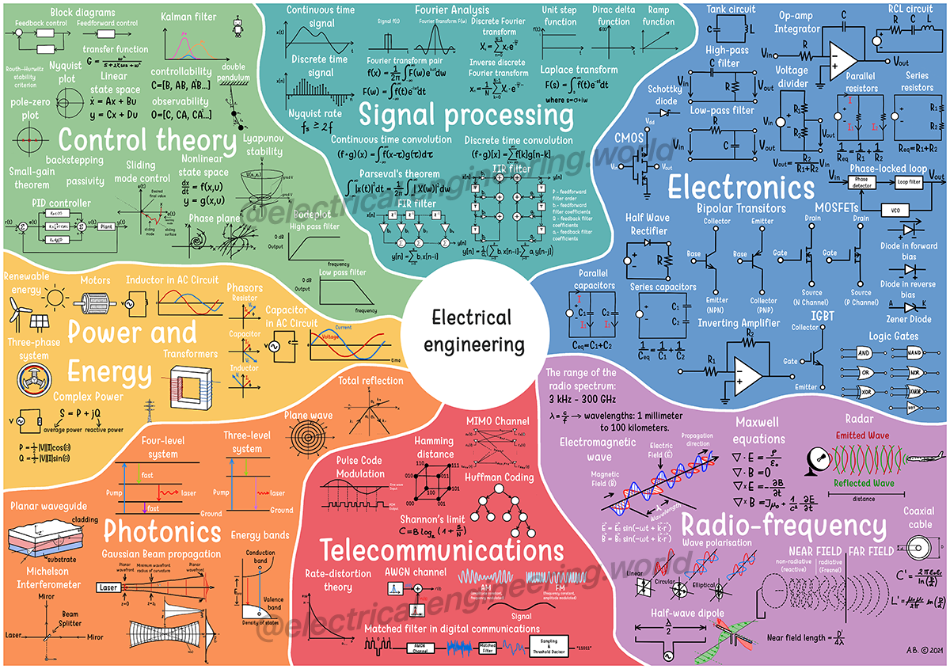
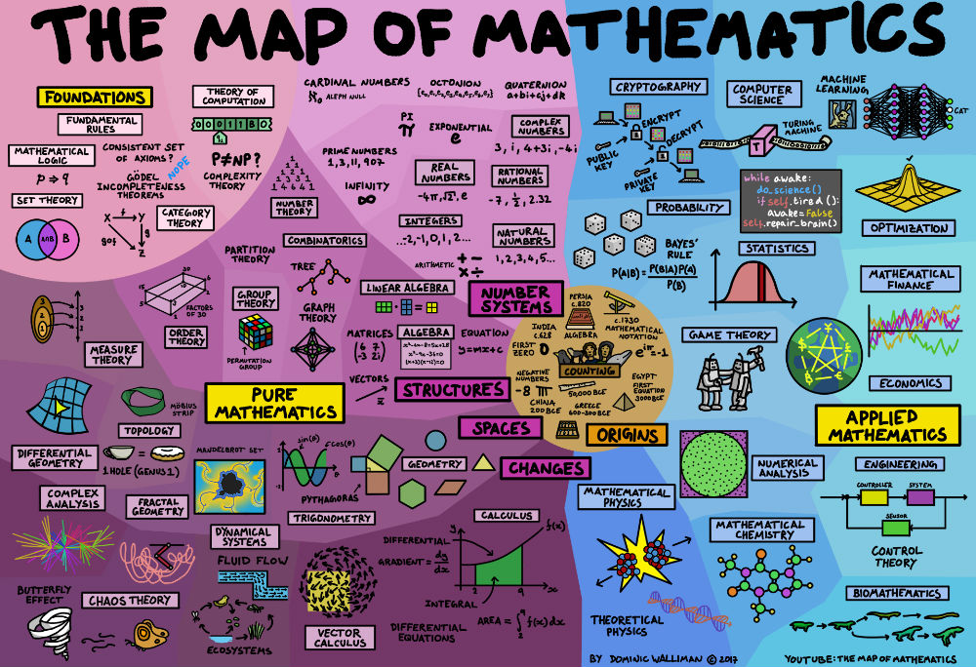
My Background
MSc in Electrical & Computer Engineering
BSc in Mathematics
BA in Foreign Languages

Slide 3
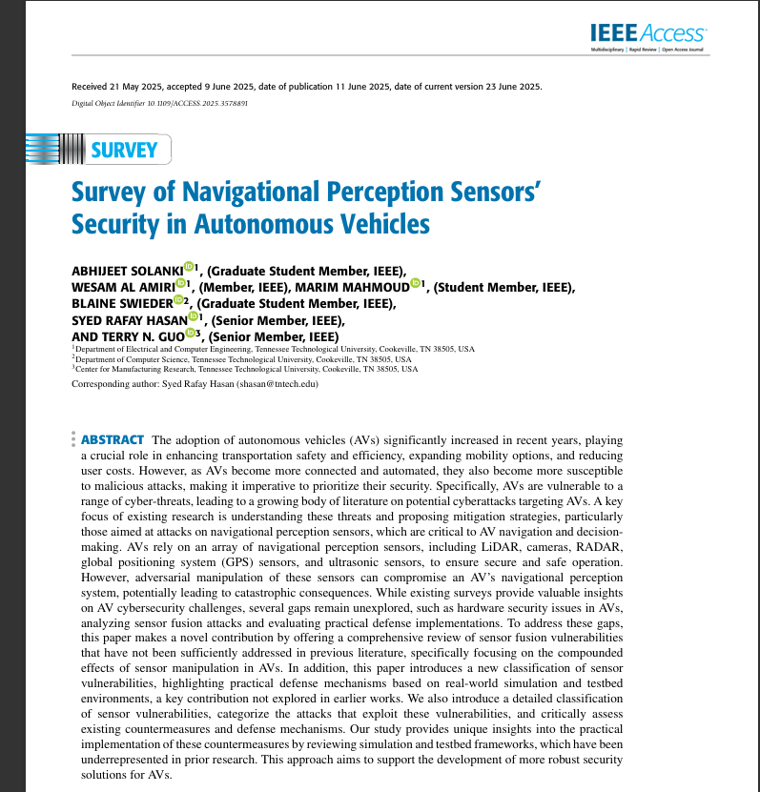
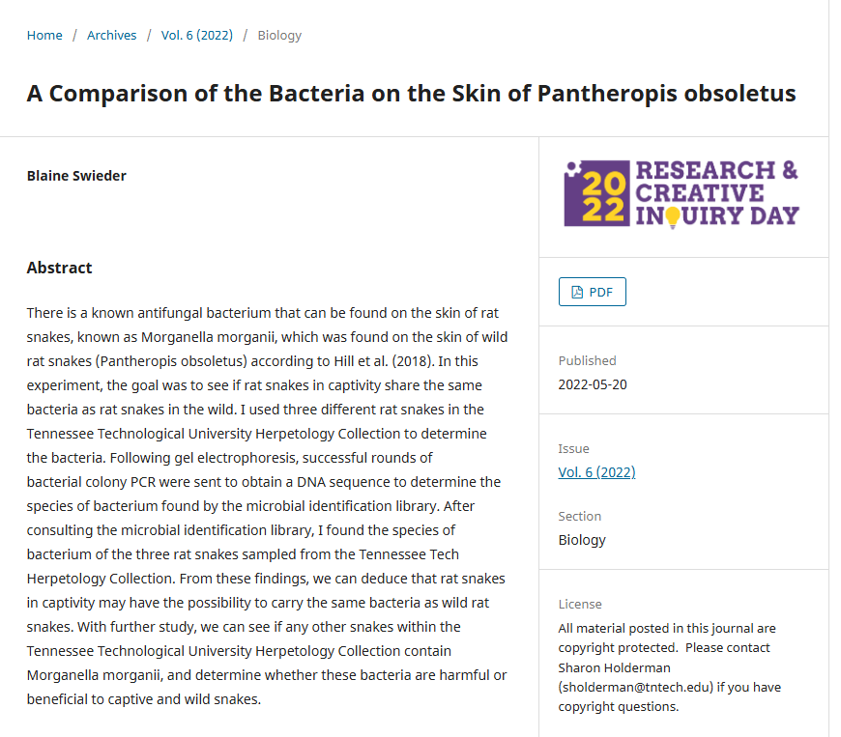
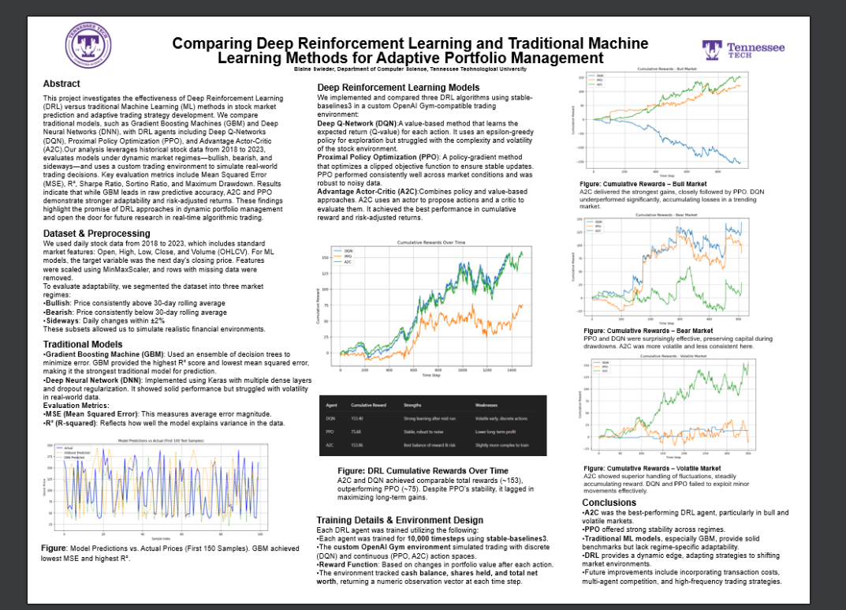
Previous Research Experience

Slide 4
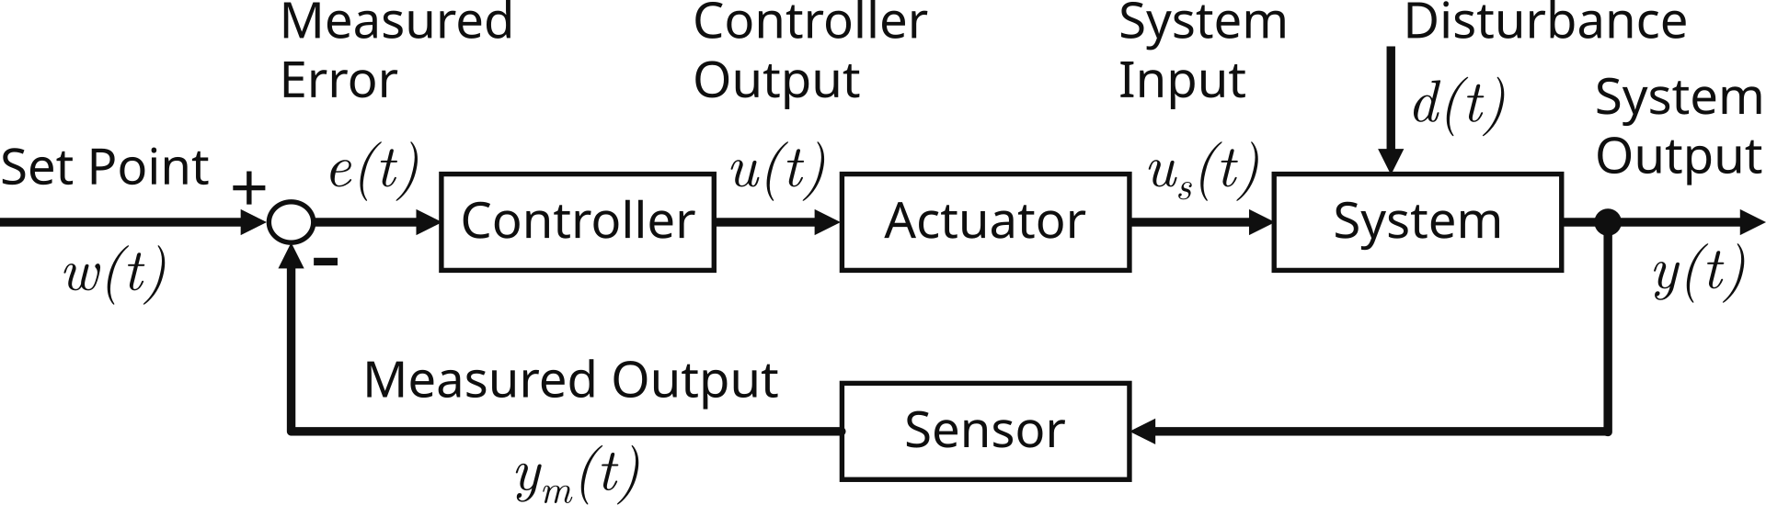
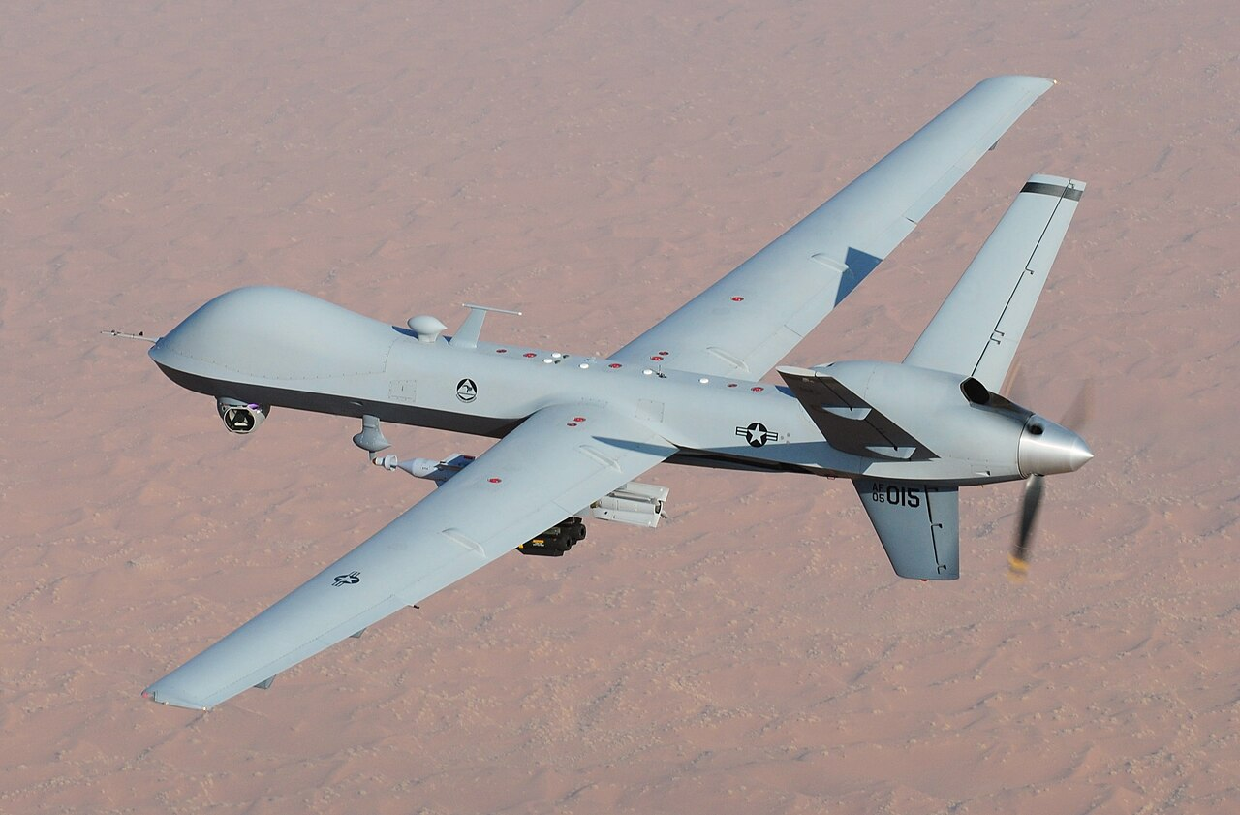
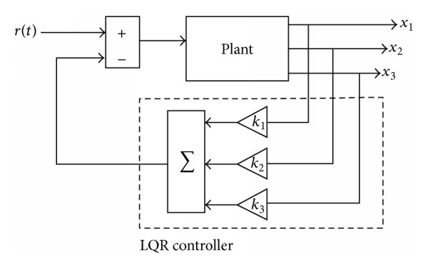
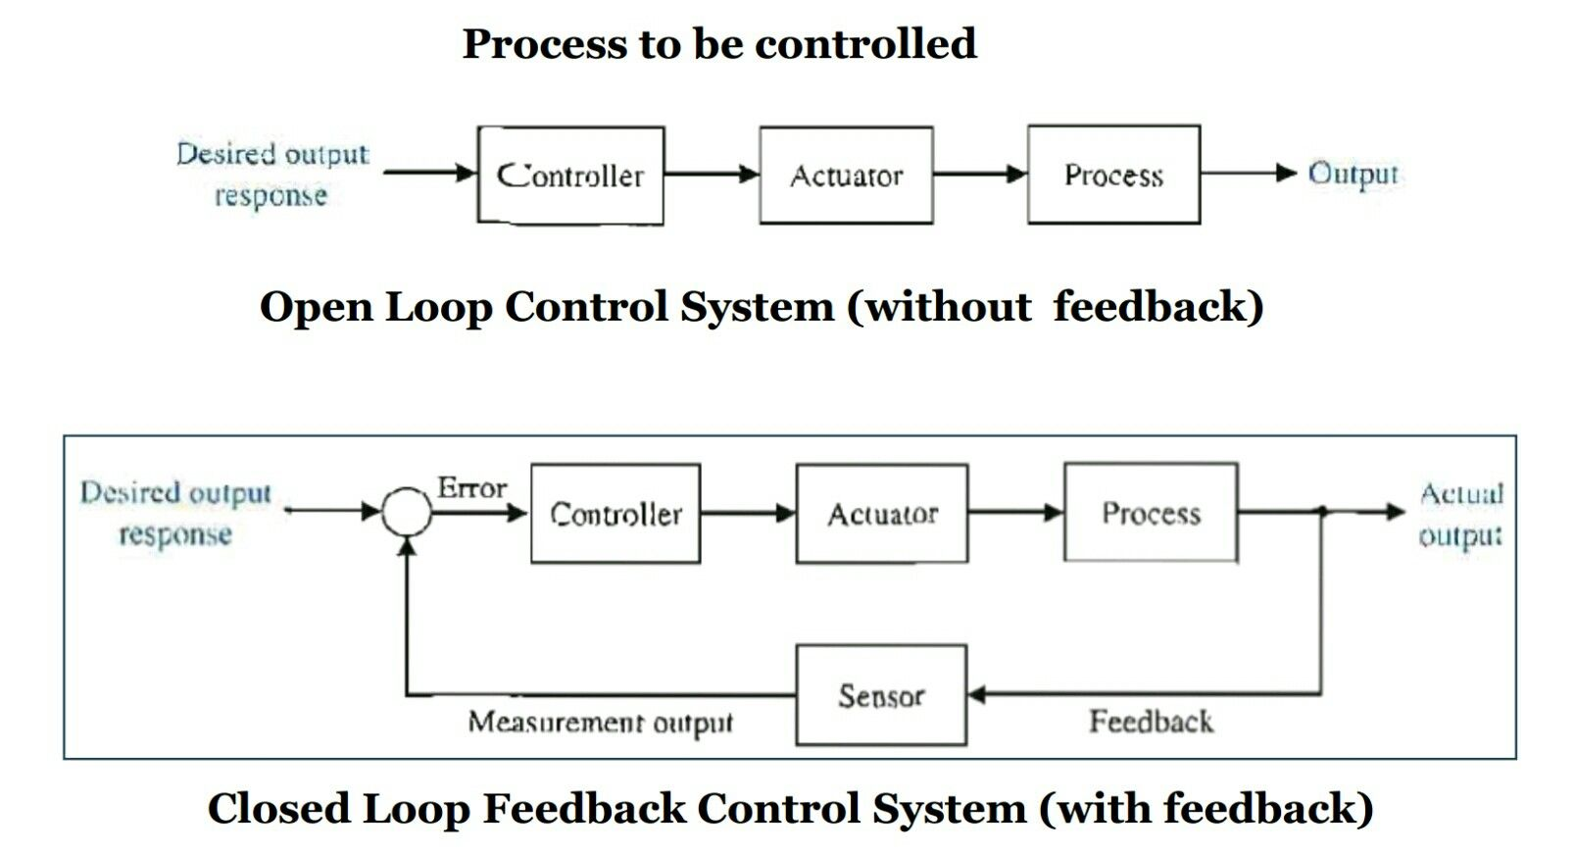
Current Research Directions
Control Theory & Systems
Dynamical Systems
AI for ECE & Aerospace Engineering

Slide 5
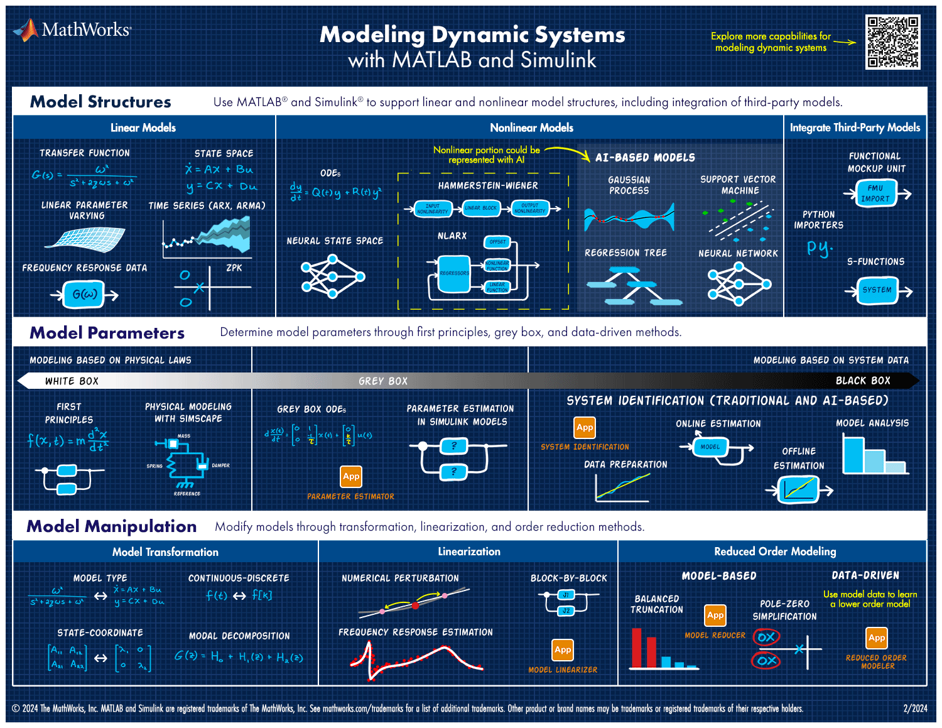
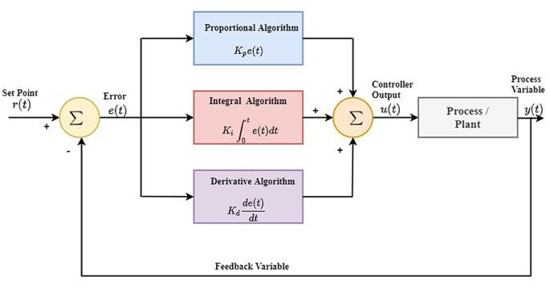
Methodology
Start with simulation models of dynamic systems.
Compare classical LQR/PID control versus AI-based adaptive control.
Analyze performance in terms of settling time, stability, and energy efficiency.

Slide 6
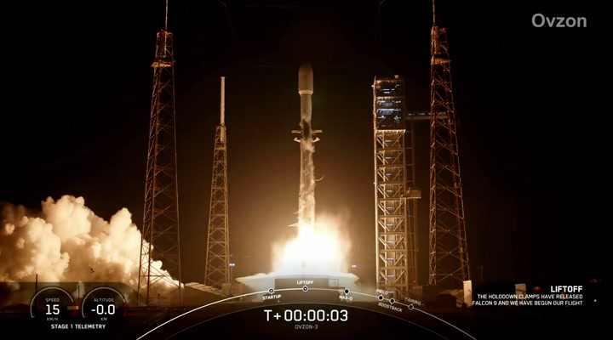
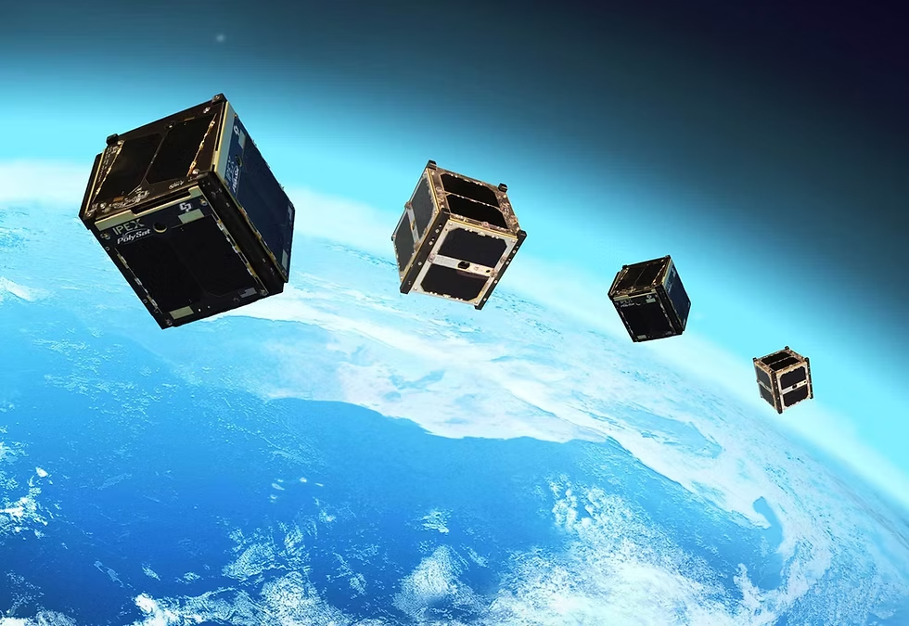
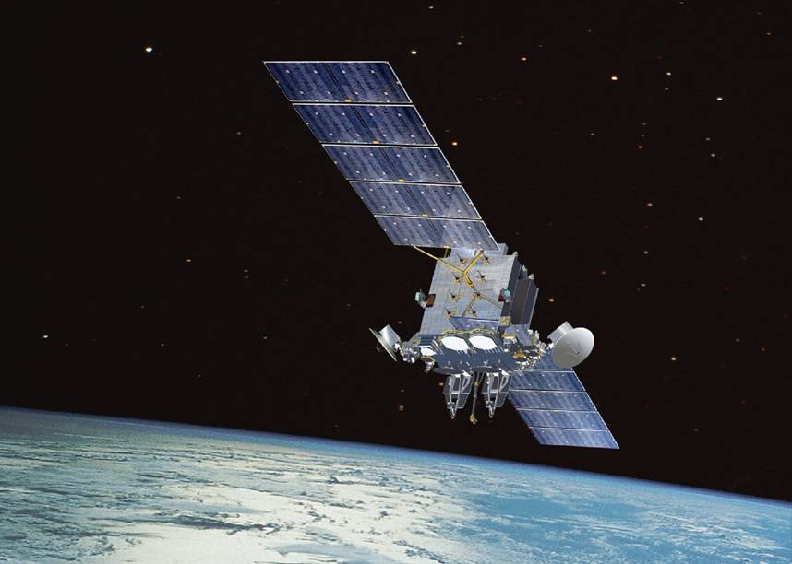
PhD Direction & Vision
PhD in Aerospace Engineering ’30
Space Situational Awareness & Autonomy
Goal: “Can intelligent control algorithms enable satellites to autonomously avoid space debris while maintaining stable orbits?”

Slide 7



Summary
My focus area: Controls and AI for Dynamic Systems.
My research goal: To make autonomous systems – on Earth and in space – more resilient.
My long-term vision: “To develop AI-enhanced control systems that help solve the space debris problem.”

